Slide 1
Primary 7 Ambassadors
By Ryan, Sean and Eilidh

Slide 2
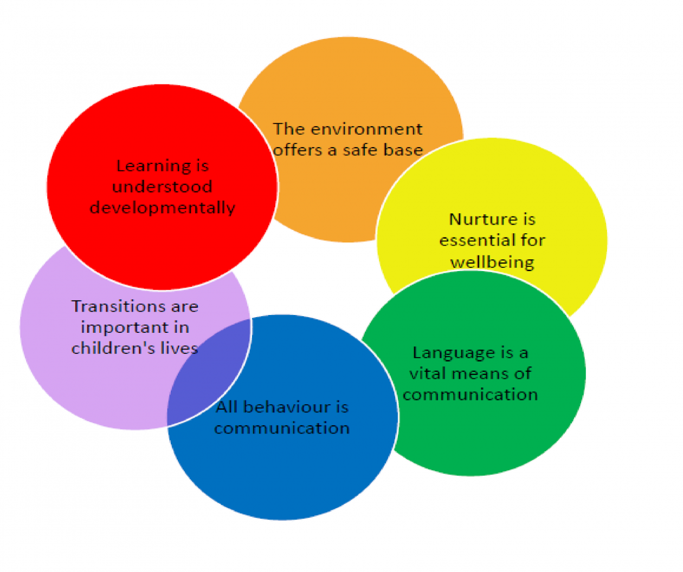
Nurture Ambassadors
Layla Martin
Myley McCann
Cara O'Hagan
Thomas Walker

Slide 3
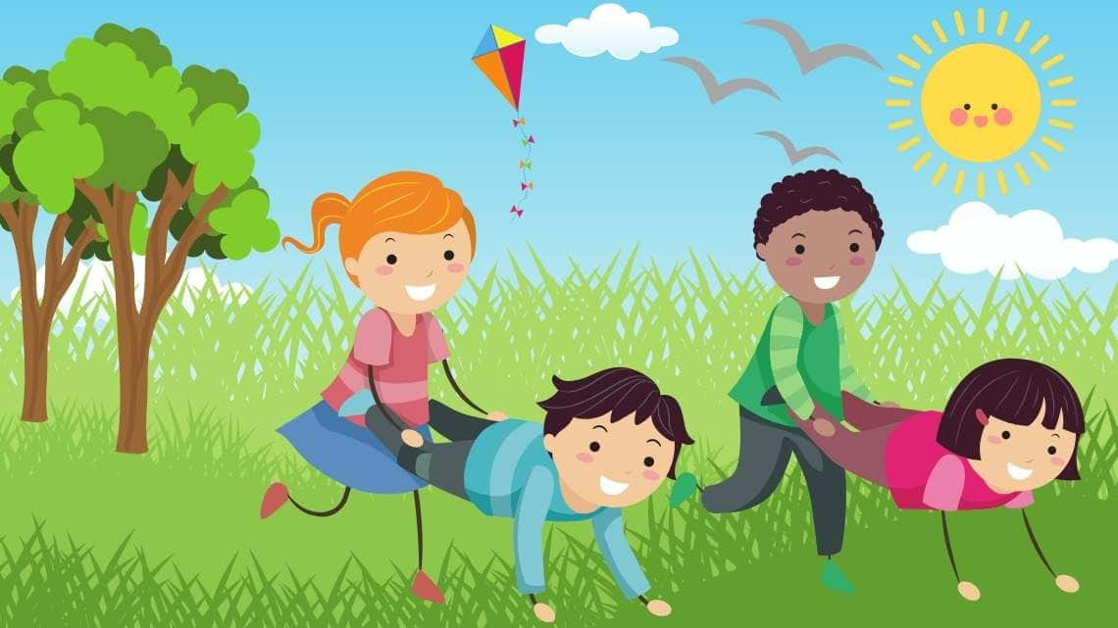
Play Ambassadors
Myla Hutton
Cara Clark
Euan Defelice

Slide 4
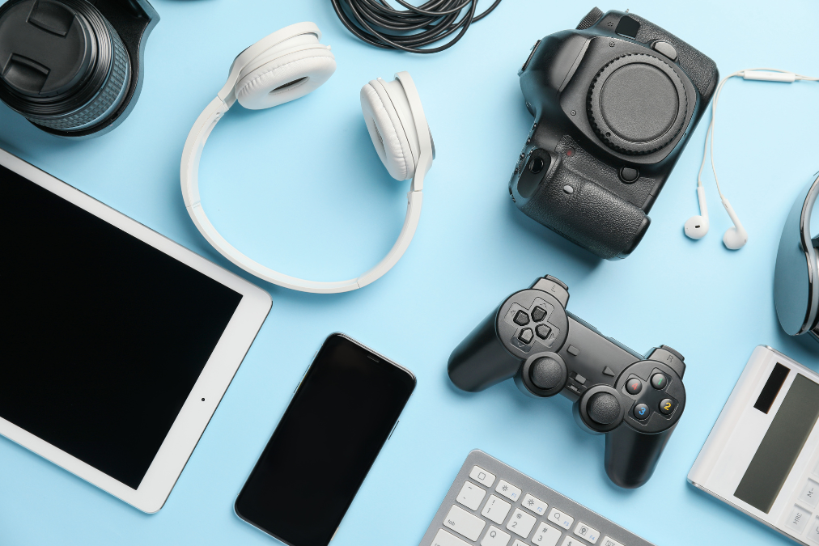
Digital Ambassadors
Jack Parkingson
Jackson McCann
Reuben H Noble
Jake Currie

Slide 5
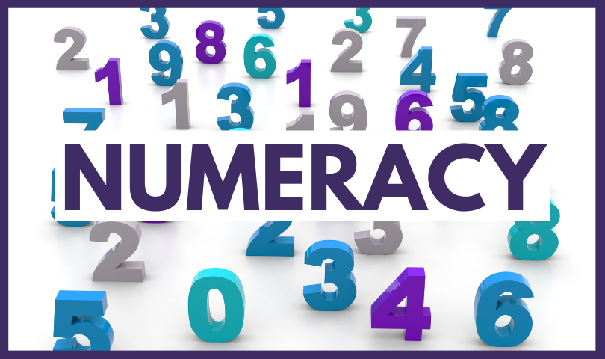
Numeracy Ambassadors
Carson Livingston
TJ Brownlie
Euan Alexander

Slide 6

STEAM Ambassadors
Laurence Gosetti
Demi-Leigh Wilson
Reece Johnston
Jaxon Diop

Slide 7

Reading Ambassadors
Andrew McIntyre
Lucas Rodgers
Aryan Ravish

Slide 8

Literacy Ambassadors
Ryan McGrory
Sean McInnes
Eilidh Hodgart

Slide 9
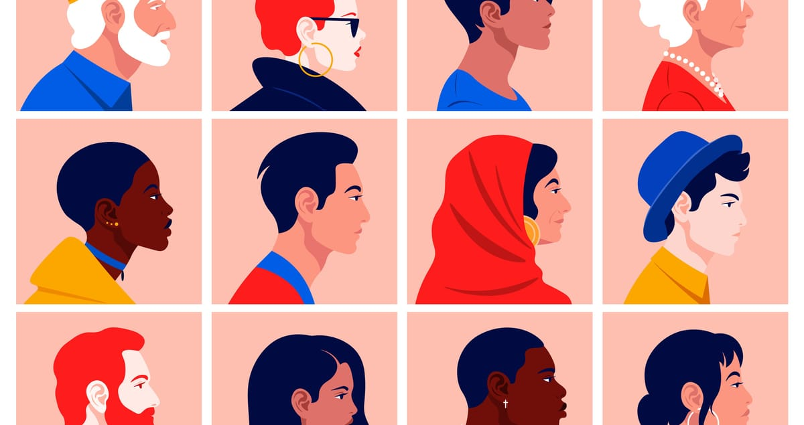
Diversity Ambassadors
Millie Ferguson
Ava Lee
Carson Huey

