Slide 1
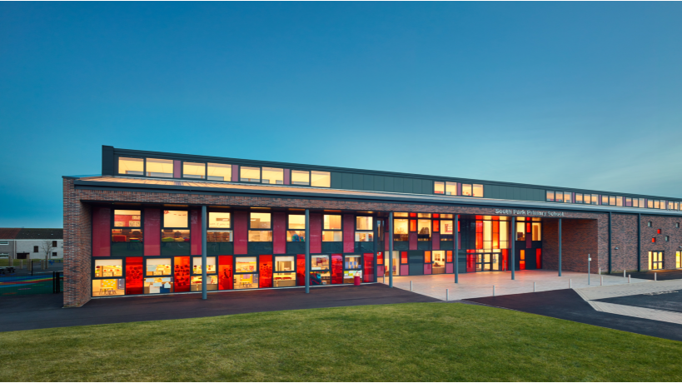
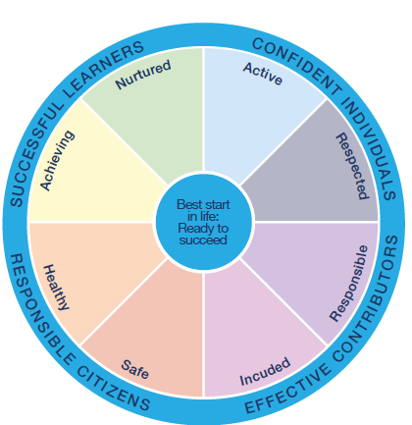

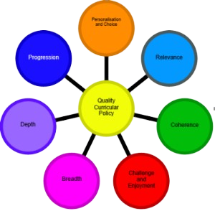
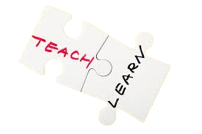
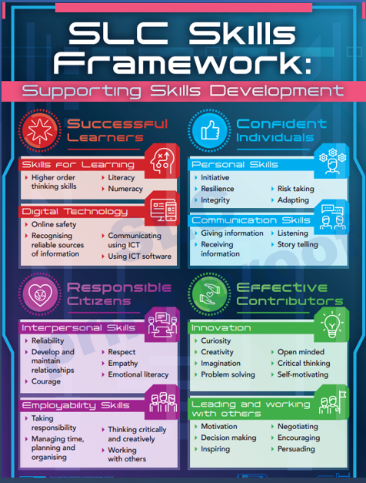
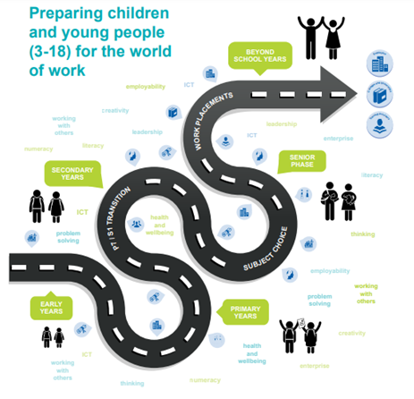
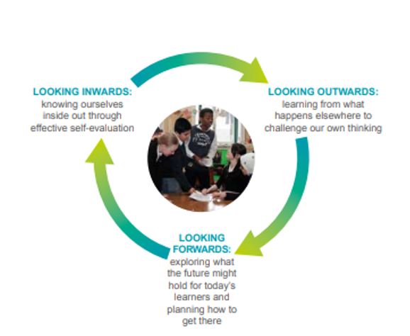
South Park Primary School
Curriculum Rationale & Design
GIRFEC
CfE
In South Park we aspire to REACHexcellence in all that we do...
The decisions we make as a school will be based on a commitment to ensuring that our children’s health, wellbeing and progress are our prime concern: Children First!
We aim to provide a safe and stimulating environment where all children can achieve their full potential.
We aim to enable children to become successful learners, confident individuals, responsible citizens and effective contributors.
We aim to empower staff to develop to their full potential and develop leadership capacity.
Teaching staff are empowered to implement a range of effective approaches and strategies to provide enriching learning experiences
We aim to promote partnership and engagement with the wider community for the benefit of the school and the community.
Through continued self evaluation, consultation and improvement we aim to offer the highest quality education for pupils in an environment in which the pupils feel secure, valued and confident.
We aim to involve all stakeholders and effectively use local and national guidelines to produce effective policies and planning.
Through the professional review and development process and high quality CLPL opportunities, we will support and encourage all staff to carry out their roles effectively.
We aim to maximise the use of our resources and our partnerships with other agencies for the benefit of the school.
Through a system of distributive leadership we aim to develop leadership capacity at all levels to take forward the shared vision of the school.
LEARNING
&
TEACHING
Our Learning Journey
What do we want?
How can we achieve this?
DYWF
HGIOs4
South Park
Community
LEARNING
&
TEACHING
VISONS
&
VALUES
South Park
Primary
DYWF
GIRFEC
CfE
“When a school has a rationale for its curriculum, it means that everyone involved with the school can answer the questions ‘What is it we want for these children?’ and ‘What are we
going to do to achieve it?’”Education Scotland

Slide 2
We work in partnership with families, specialist services, outside agencies and other establishments to help us ensure that every child achieves their full potential. Our aim is to provide consistently high quality learning experiences, value the learning and achievements of all our children and promote high expectations and ambition. We aim to support our pupils to develop the knowledge, skills and attributes they will need to blossom in life, in learning and in the work place.
Children First
Community
Ethos
Diversity – Being Me
Relationships
High Expectations
Community Partnerships
Our
Families
Equal Opportunities
Nurture at South Park:
At South Park, the social and emotional wellbeing of our children and families are paramount to our school community. We prioritise building positive, attachment informed, trauma sensitive relationships to ensure our families feel supported and nurtured. Over the past 7 years, we have dedicated our efforts to developing 3 nurture spaces now known as our ‘Nurture Hub’. The Nest is our safe space where facilitate a variety of Nurture Groups. The Sanctuary is our multi functional space both parent support groups and one to one support for our learners. Lastly, The Jungle is our sensory space utilised by all age groups to support regulation. Our Hub is supported by four members of staff all with a range of experience and expertise.
Community Garden
Beyond
South Park
'The Nurture Hub
Forest Schools
Being South Park
Our Unique Identity
In South Park we aspire to REACH excellence in all that we do...

Slide 3



Children First
Numeracy
Literacy
Play based learning
Pupil led enquiry based
learning
HWB
At South Park we enable our learners to be equipped with the skills to flourish in their learning and their life beyond South Park.
We have a responsive curriculum which places pupil voice at the heart, encompasses global goals and reflects the contexts of our whole community.
Being South Park
Our Unique Curriculum
Community Garden
In South Park we aspire to REACH excellence in all that we do... ​

