Slide 1

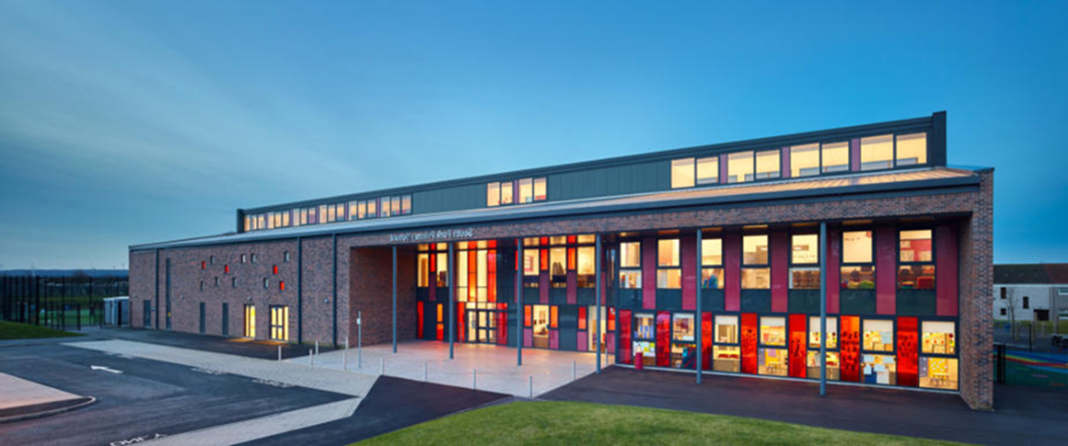
South Park
Standard and Quality Report 2023-2024
What we achieved and our focus for improvement this session​…

Slide 2




About us
South Park Primary School is situated in the Murray, East Kilbride and serves local children from 2 years through 12 years from the Greenhills, Westwood and Murray areas of the town. The New Build for South Park was completed in August 2014. The school opened to pupils on 18th August 2014. There are 7 mainstream classes from Primary 1 to Primary 7 with an average roll of 170, a 40 - 2 to 5 Nursery Class. The school has a Head Teacher and a Principal Teacher and 10 class teachers, both full-time and part-time in school. We have 7 members of staff in our nursery classes, a Team Leader and 7 Early Years Workers and 1 Early Years Support Worker. We benefit from 2 support staff in our school office and 5 school support assistants in our classrooms.
Our school vision and values are embedded in the culture and ethos of our school. The 5 values which were chosen by all stakeholders:
Respect, Equity, Ambition, Confident and Happy
These values underpin our vision of ‘Aspiring to REACH excellence in all we do…’
We work in partnership with families, specialist services, outside agencies and other establishments to help us ensure that every child achieves their full potential. Our aim is to provide consistently high-quality learning experiences, value the learning and achievements of all our children and promote high expectations and ambition. We aim to support our pupils to develop the knowledge, skills and attributes they will need to blossom in life, in learning and in the workplace.
Pupil achievement is valued and celebrated throughout the school and from year to year we offer a wide variety of sporting and cultural activities, which include netball, football, multi-sports, cricket, digital, arts and crafts. These activities provide pupils and families with a variety of opportunities to develop, explore and excel in new talents.

Slide 3

What we achieved in 2023-2024…
Numeracy
Our attendance for the school session was 91.5%
Literacy
Our combined attainment in Numeracy in P1, P4 and P7 was 80.2 % which is 1% above the average for Scotland.
Our combine attainment in Literacy in P1, P4 and P7 was 75.3% which is 3% above the average for Scotland

Slide 4


Priorities Impact
To enable our learners to be equipped with the skills to flourish in their learning and their life beyond South Park.
We will continue to develop a responsive curriculum which places pupil voice at the heart, encompasses global goals and reflects the contexts of our whole community.
Curriculum Rationale created using one page format. Project Leadership groups established across P4-7. SLC Skills Framework evident in planning and learning and teaching across the school. NQT focus on Skills Framework for assessment in Practitioner Enquiry. Pupils are QR coding and evidencing skills. Rolled out to authority. P2/1 teacher trained in using 'Teaching Sprints' approach. P7 teacher to be trained in 'Teaching Sprints' next term. IDL case study published by authority. Learning walks to triangulate evidence in planning.
Curriculum
Easy to use

Slide 5
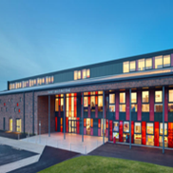
Priorities Impact
Following staff/children and parent /carer feedback and observations the negative impact of social media was recognised and indicated a misinterpreted understanding and application of the UNCR, wellbeing indicators and ability to celebrate diversity
Diversity Leadership and Project Groups established.
Whole school community events planned and held – Diversity show-case and workshops held.
All staff completed Level 1 LGBT Training.
P5, P6, and P7 – Participated in Race and Equality Workshops with the West Partnerships.
New resources bought with diversity in mind – Library books, class texts, health and wellbeing etc.
Diversity Group visited Calderwood for their Celebrating Being Me Event.
Equality and Diversity

Slide 6
Priorities Impact
Following robust assessment and learning community moderation in writing it has been identified that learners are not yet on track. The evidence identified the focus being on the tools for writing and the need for breadth of benchmarks being implemented across first level.
Draft writing criteria created and shared with staff to trial.
Cross level and in-house moderation taking place.
Early Years Practitioners involved in all parts of the process.
Bespoke writing approaches being trialled, evaluated, and adapted across school and in particular P1 and 2.
LC CAT night to moderate draft writing criteria arranged for after Easter Break.
Consultations with staff inhouse and across learning community.
Stretch aim children evaluated by LC Moderation Group to ensure robust moderation using new moderation criteria.
Almost all stretch aim children now on track.
Final writing criteria shared with learning community.
Writing
Attainment

Slide 7

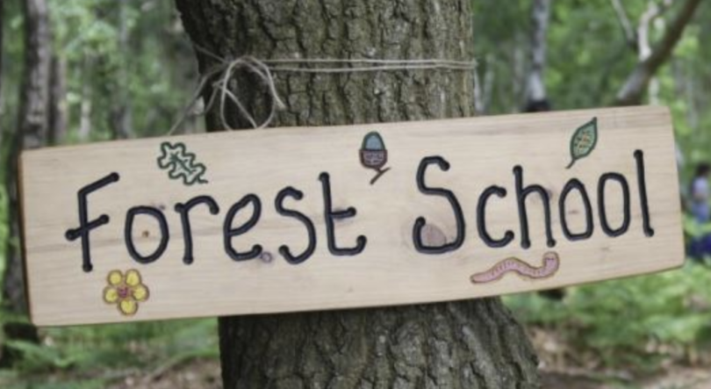





What actions should we take next into 24-25?
Level 2 LGBT training to be completed by all staff at the beginning of next session.
Audit of planning to ensure equality and diversity is evident.
Learning walks – triangulation of evidence – planning – learning and teaching and school ethos.
Monitoring of Bullying and Equalities Pro Forma.
Continue to work in partnership with Calderwood Primary Leaders of Learning.
Continue with themed days/weeks to further embed equality and diversity within school led by Diversity leadership group.
Create writing policy and guidance. Writing attainment data informed by new moderated criteria, professional judgement/discussion/moderation. Ensure 2 genres covered per term from P4-7. Continue to track cohort data on writing to ensure wide coverage of genres across levels. To devise clear guidance on writing approaches used across Early and into First Level.
Audit of planning to ensure coverage of the curriculum.
Planning to reflect coverage of Global Goals, UNRC and Skills Framework.
Planning, Evaluation and Moderation meetings to ensure coverage and inclusion of skills framework, Global Goals and UNRC across all stages.
Further develop pupil articulation of skills using digital technology.
Further implementation of inquiry-based learning in P4-7.
Forest Skills across the school

Slide 8
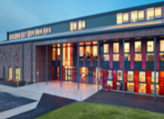


At South Park we Aspire to REACH Excellence in all we do…
If we can’t do it or haven’t done it…we just can’t do it or haven’t done it YET!

Slide 9
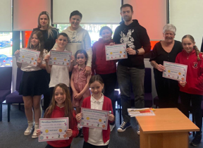
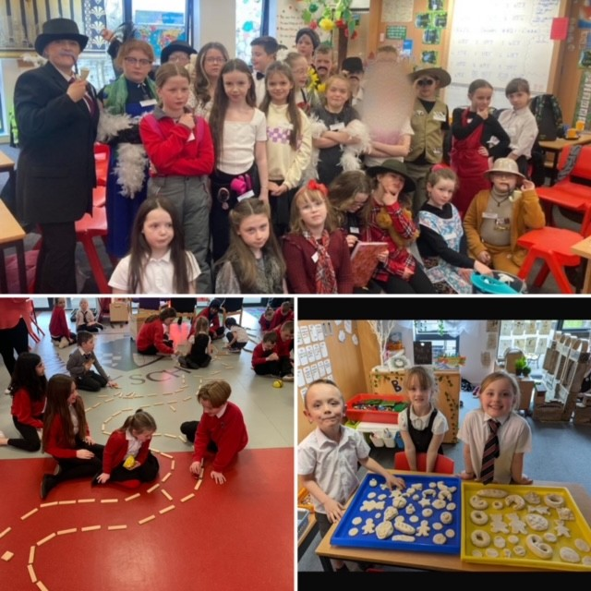
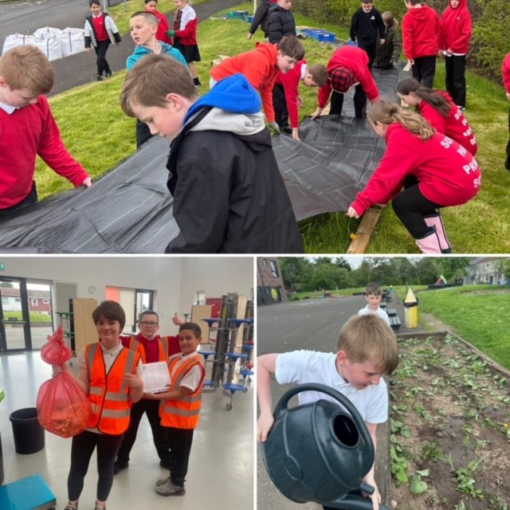
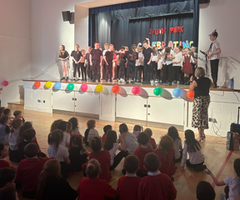
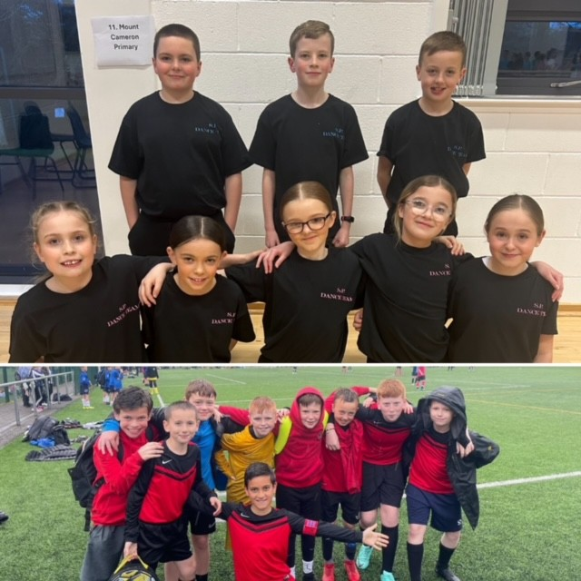
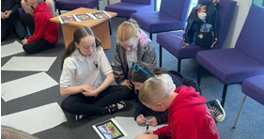
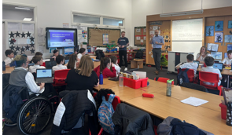
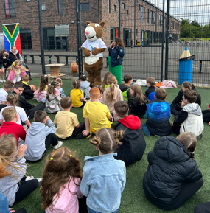
A snapshot of our achievements in 23-24
We continued to engage in parent partnerships.
We continued to explore play pedagogy throughout the school.
Our ‘Waste Warriors’ and ‘Community Garden’ groups helped raise awareness about sustainability.
We celebrated diversity and hosted our first ‘Celebrating Me’ event.
We excelled in extracurricular activities and represented our school at various SLC events.
Our Young Leaders built partnerships across SLC.
We engaged with SLC’s development officers & upskilled our staff and pupils in ICT.
We raised funds for local charities

